Slide 1
ARCH 655 Parametric Modeling in Design
Vector Mathematics:
Applications
Wei Yan, Ph.D.
Associate Professor
Department of Architecture
Texas A&M University

Slide 2
Use of Dot Product

Slide 3
Extract the projection
The dot product between the unit x vector (1,0,0) and a vector V gives the component of V in the x-direction.

Slide 4
Work out the angle between 2 vectors
cos(theta) = a.b / (|a||b|)
= (a1*b1 + a2*b2 + a3*b3) /
(sqrt(a1² + a2² +a3²) * sqrt(b1² + b2² +b3²))

Slide 5
The Dot Product measures the 'Right-Angularity' of 2 vectors
Vectors a and b are orthogonal if, and only if, a.b = 0.

Slide 6
Use of Cross Product

Slide 7
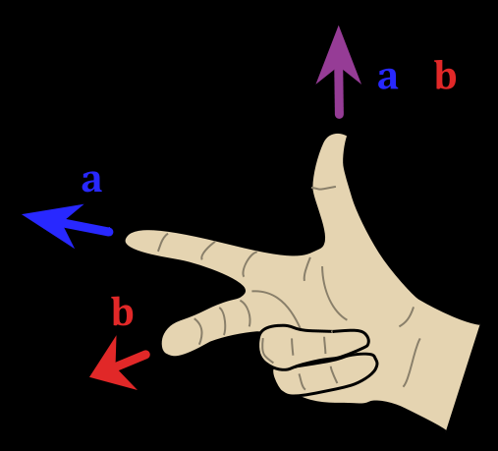
Cross product of 2 vectors, results in 3rd vector which is perpendicular to both of them.
For finding surface normal

Slide 8
|a x b| = |a||b|sin(theta) = base * height
The length of the cross product is the area of the parallelogram made by the two vectors.

Slide 9
Use of vectors
Many problems can be solved most easily by using vector operations. (And some problems can't really be expressed very well, without reference to vector operations.)
Geometry: find normal, find average direction of two lines, find projection, …
Physics: velocity, force
Notes:
http://www.mathrec.org/vector.html

Slide 10
General Tools
http://www.wolframalpha.com/input/?i=vector+%281%2C+2%2C+6%29+%2B+%284%2C+5%2C+3%29

